Slide 1

Puppies, Sharks, bears – Oh my!
Ellen Reat, Nadia Nishu, Andy Trow
Introduction to Data Science
Final Project
December 2, 2016
Notes:
Hi everyone, this is Puppies, Sharks, and Bears – oh my! by Ellen Reat, Andy Trow, and Nadia Nishu as our project for the University of Utah’s Introduction to Data Science class, Fall 2016.

Slide 2
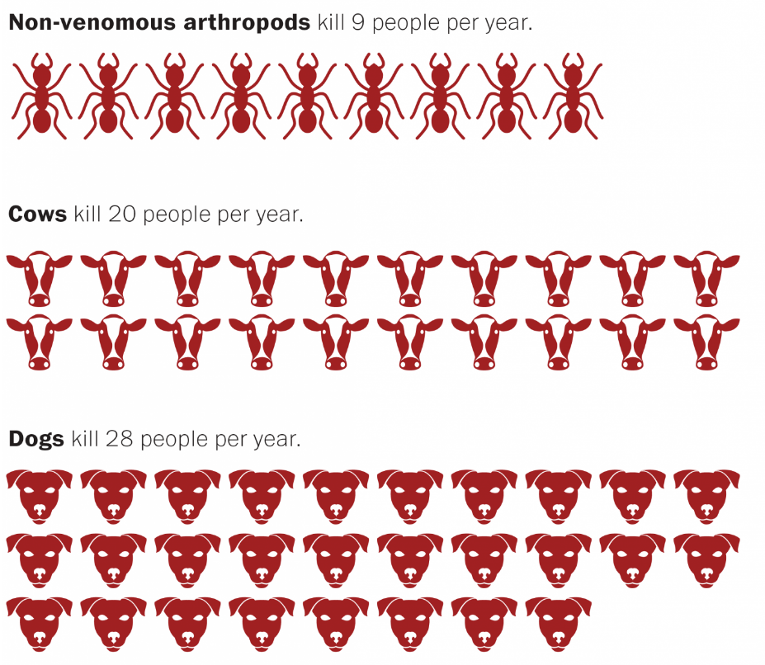
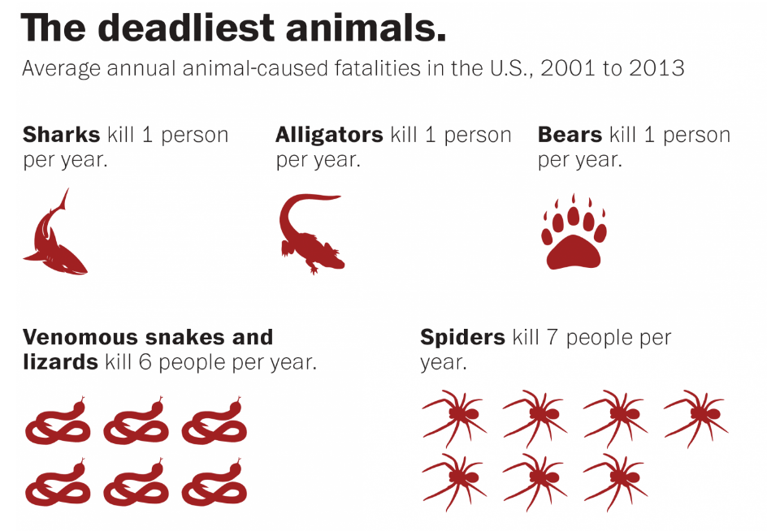
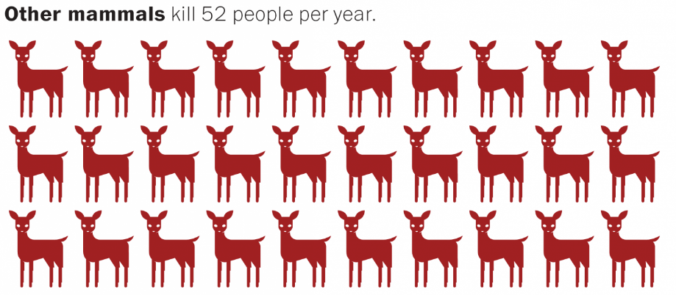
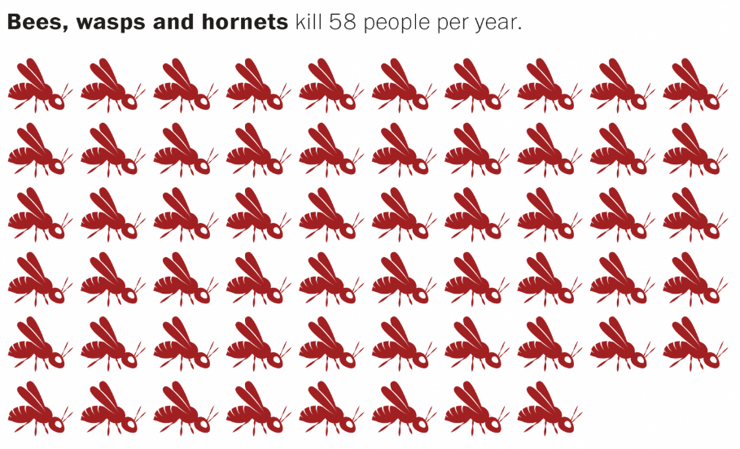
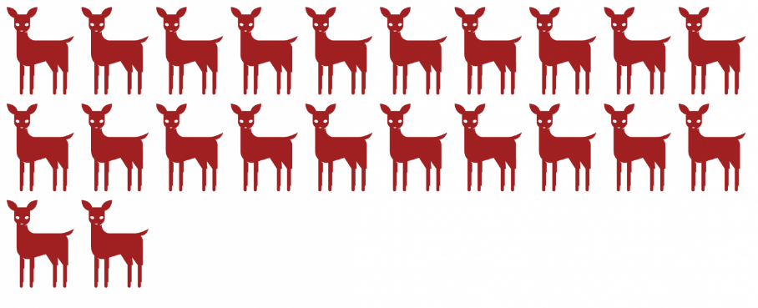
Deadly Animals
https://www.washingtonpost.com/news/wonk/wp/2015/06/16/chart-the-animals-that-are-most-likely-to-kill-you-this-summer/?utm_term=.56a0c8e438f6
Notes:
So it turns out that the animals we think are dangerous don’t actually kill the most people annually. Dogs are significantly more fatal than sharks or bears, but “other mammals are the most fatal”.

Slide 3
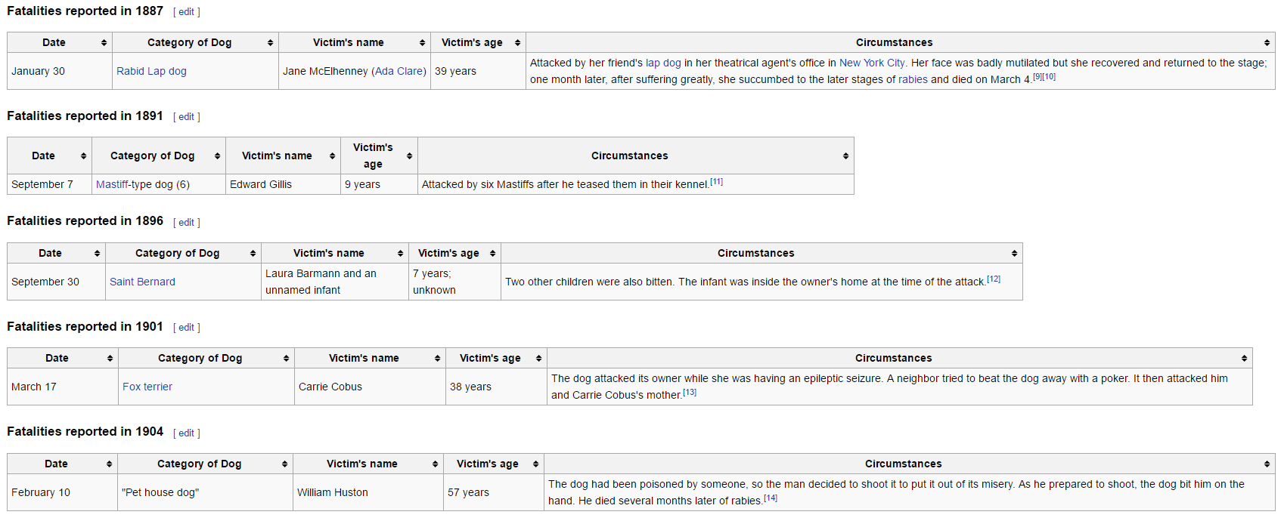
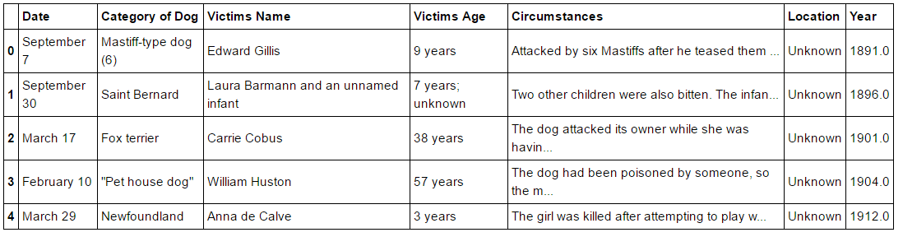
Data collection & Cleaning
Webscraping from Wikipedia tables posed significant challenges
Global Shark Attack dataset was more complete and robust
Dogs → N = 584
Bears → N = 156
Sharks → N = 5992

Slide 4
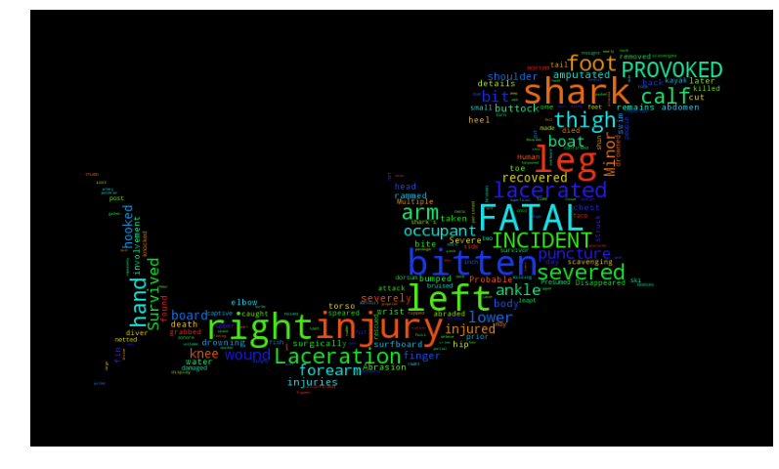
SHARK attacks
Notes:
We have analyzed data from the Global Shark Attack File, this dataset is maintained by The Shark Research Institute in order to better understand behavior of sharks. We will do some initial exploration and supervised machine learning on this dataset. It contains 5900 entries with about 10 variables mostly are categorical.
As we see, many incidents are provoked. 554 of the rows include the word "PROVOKED", which is roughly 10% of the rows. This is interesting, because we don't always think of shark attacks as due to provocation.

Slide 5
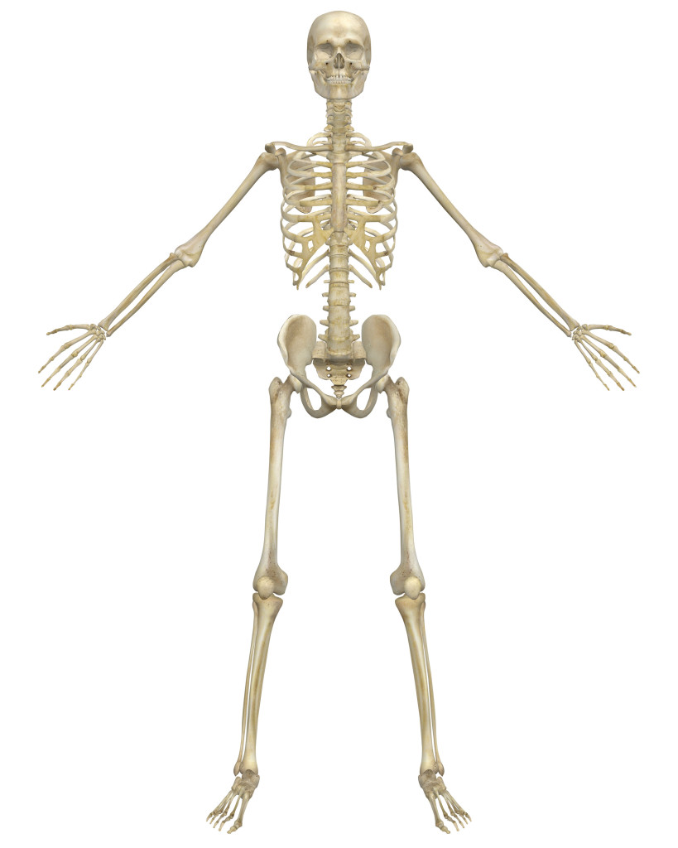
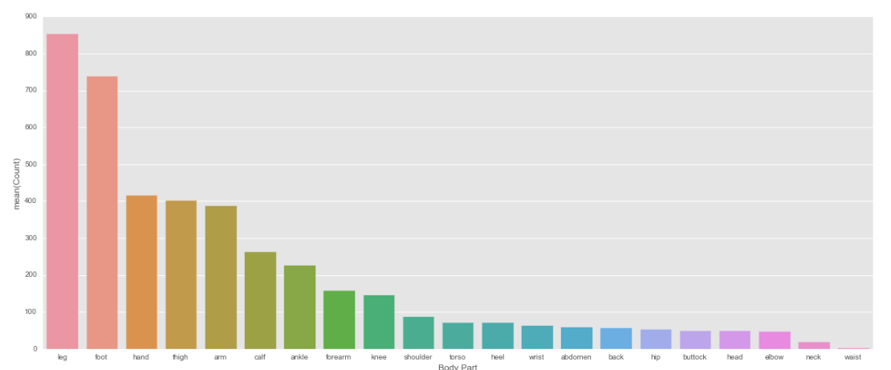
Shark Attacks Analysis
Notes:
We also see that legs, feet, hands, thighs, arms, calves, ankles, forearms, and knees are by far the most commonly bit. This is less surprising. Legs (and their parts) are large sections of the human body and logically easier for a shark to grab - very few sharks are large enough to bite/eat the torso of a human successfully. Also, sharks typically are attempting to drag and disorient their prey - or maybe humans are on surfboards and legs/arms are the easiest targets.

Slide 6
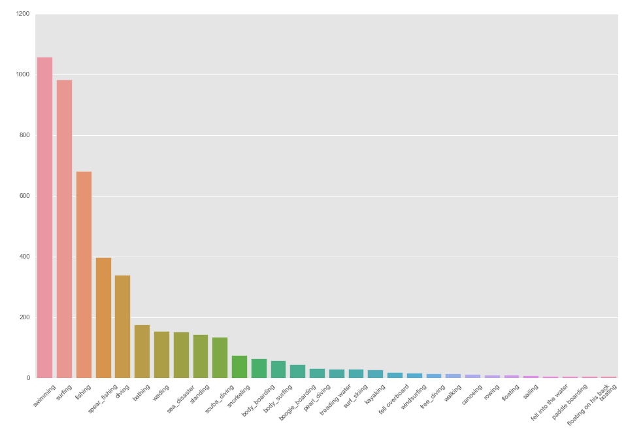
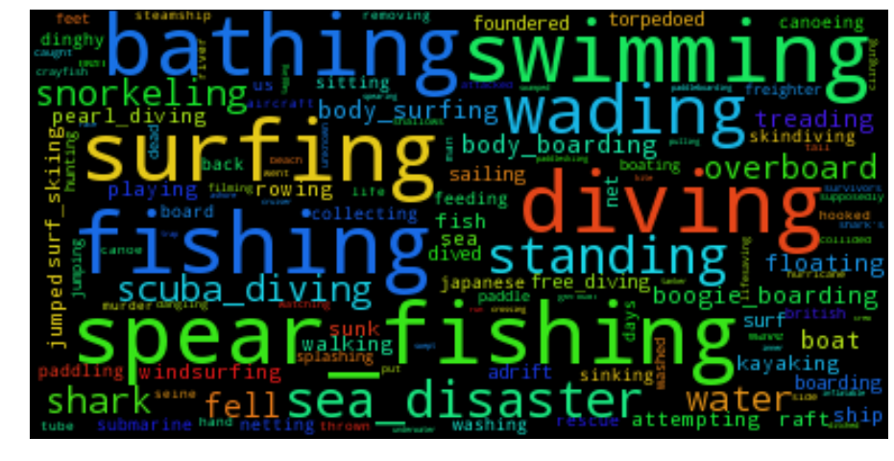
Activities
Notes:
After taking into account the descriptions that contained words that best fit into another activity we see that swimming is actually the most common activity leading to attacks.

Slide 7
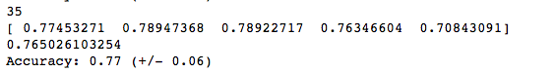
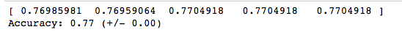
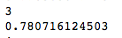
Analysis
Sci-Kit Learn supervised learning
K Nearest Neighbors
Best accuracy @ n=35
Support Vector Machine
Decision Trees
Best accuracy @ max depth=3
All roughly 75%-80%
Notes:
We want to classify survived or perished similar to the exercise using the titanic dataset.
Using activity, country, sex and type of attack we did some supervised learning on the data, to try and pick the factors that most influence whether or not a person survives a shark attack. We cross validated 5 times and calculated a final average as the mean results. We see very similar results from all three methods.
Our analysis of categorical variables didn’t end up being a very effective classifier. Essentially, had we blindly guessed that each of the victims had survived we would have been able to generate similar results.

Slide 8
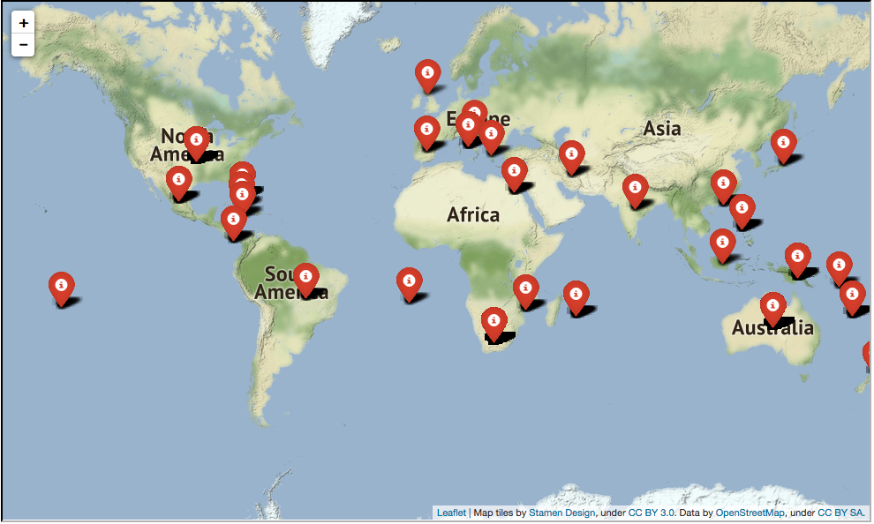
Shark attack map
Not super enlightening
Only data from three African countries
Only one data point in South America
These do not fully match shark habitat information

Slide 9
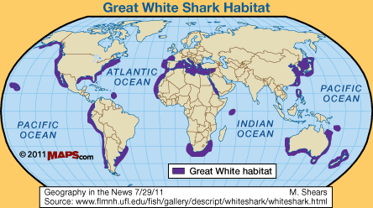
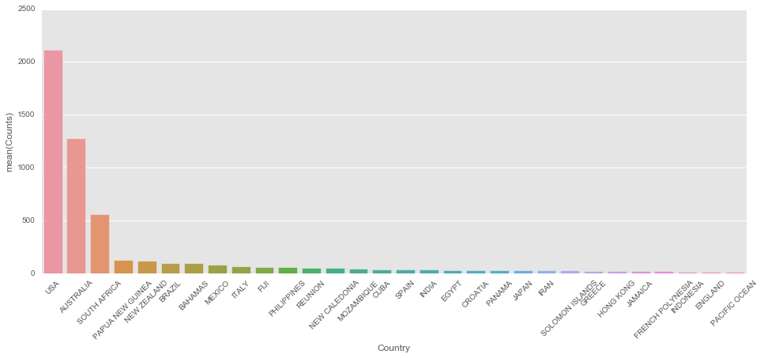
Shark attack countries
USA
Australia
South Africa
Notes:
It is interesting to note that the United States has by far the highest incidence of shark attacks, followed by Australia and South Africa. The USA has a lot of seashore, as does Australia - so this makes sense. Here's a nice article about shark habitats (specifically Great White Sharks), that may shed light as to why South Africa tops this list as well. Looks like most of the countries on this list have coastlines directly in "Great White" habitat.

Slide 10
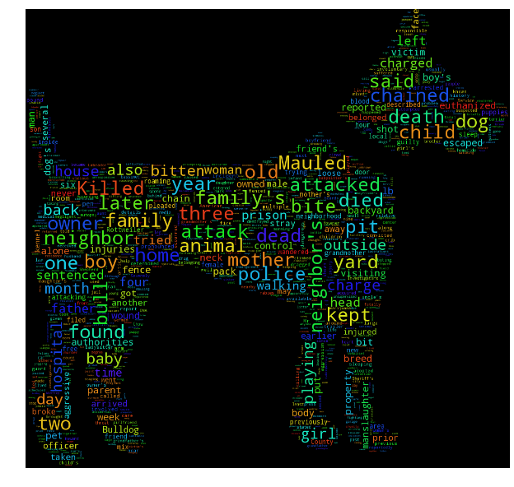
Dog Attacks
Notes:
Here, we wanted to do a visual representation of these words as well. As with sharks, this only qualititatively tells us something, but we see that "mauled" is common, as is "killed", "family", "yard", "kept", "chained", among others. There are also many numbers and many references to children, which is unsurprising as dogs are smaller animals and more likely to attack children rather than adults.

Slide 11
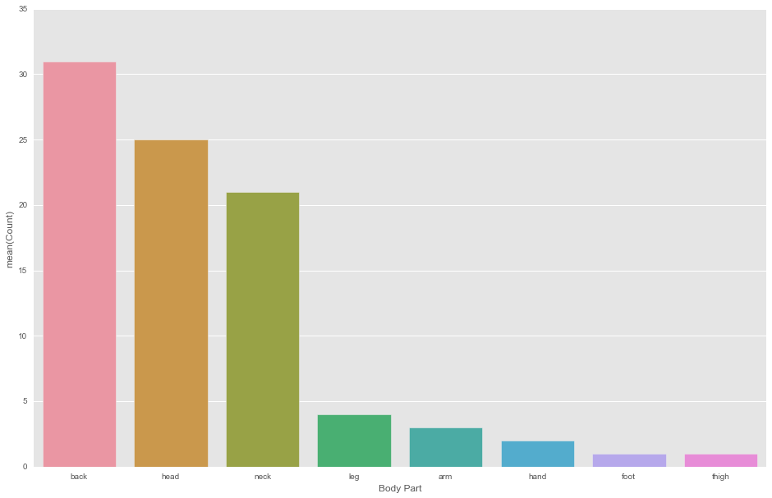
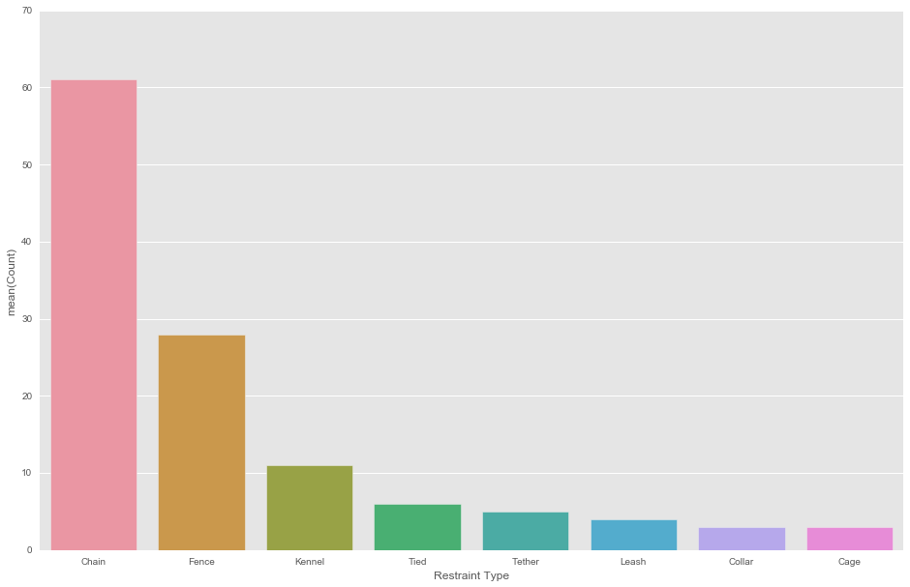
Dog attacks
Notes:
Interestingly, a number of these attacks do include a restraint of some sort. Chain is highest, while cage is lowest. It seems that chaining a dog is not the best strategy - whether this is an unsuccessful restraint or whether the chaining has something to do with dog aggression, remains to be seen.
Turns out back, head, neck are the most commonly attacked body parts for dogs. This maybe makes sense...dogs are closer to person sized and probably want to go for heads and necks (high consequence injury areas) more than dragging a person underwater (i.e. how sharks go for legs).

Slide 12
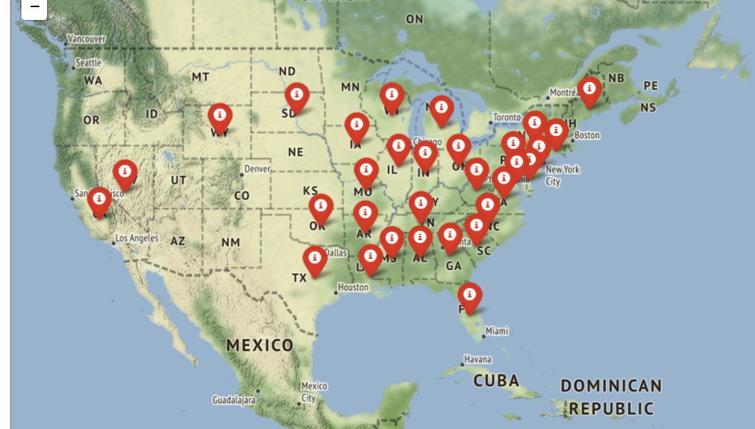
Dog attack map
Dog attacks in the United States
Notes:
Dog attacks seem to be more common in the mid-west, southeast, and northeast regions. There were no records of dog attacks in Utah, luckily!

Slide 13
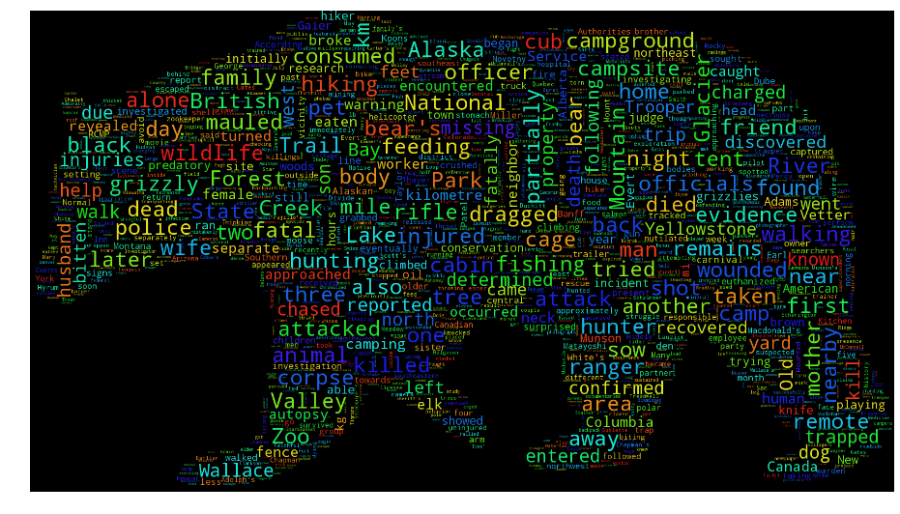
Bear attacks
Notes:
Here we see a much more "distributed" wordcloud. There aren't as many big words (more common words) in contrast to the other two animal attack types. We see lots of words that indicate outdoor activity (hiking, trail, wildlife, lake, mountain, camp, etc.) and even some location names.
Bear is the most commonly found word (which isn't surprising at all) but it is followed by killed which gives us some idea of fatality, I suppose. Attacked and found are also not suprising. Although "found" is maybe different - signifies remoteness of many of these attacks? Maul is common, like with dogs. We also see "national", "area", "hunting", "campsite", and "cabin", which all indicate some sort of outdoor activity - not surprising!

Slide 14
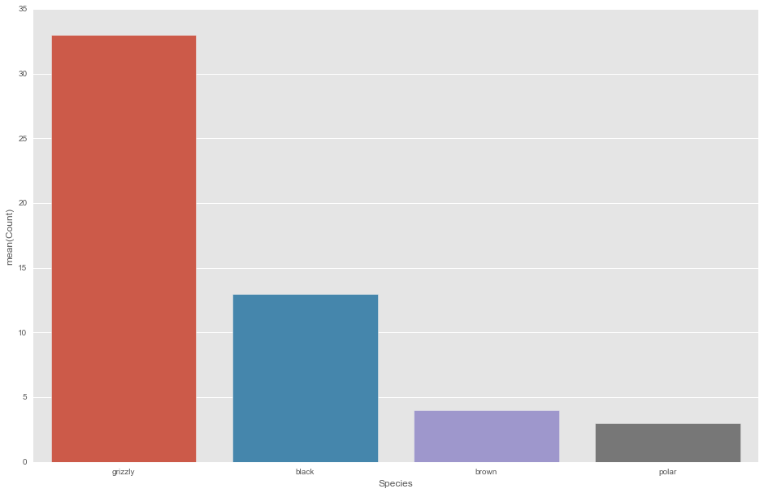
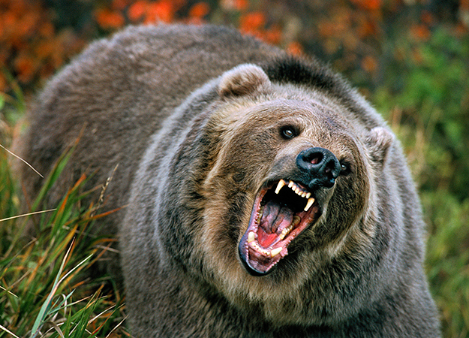
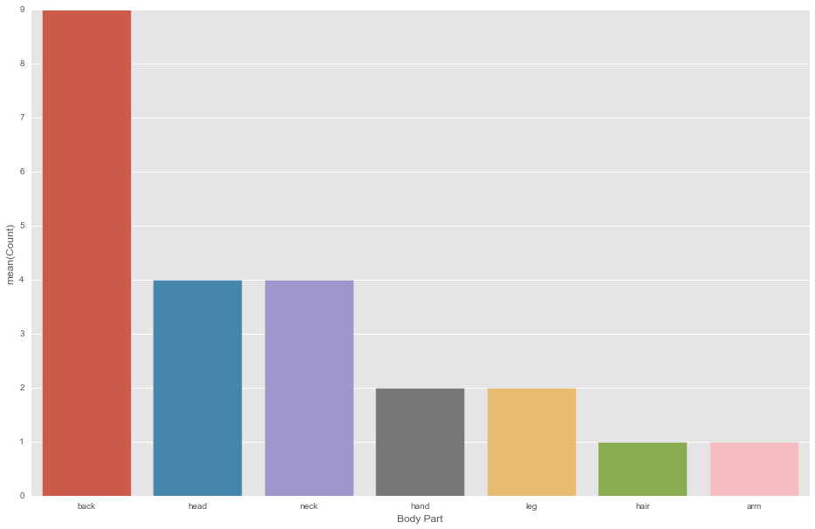
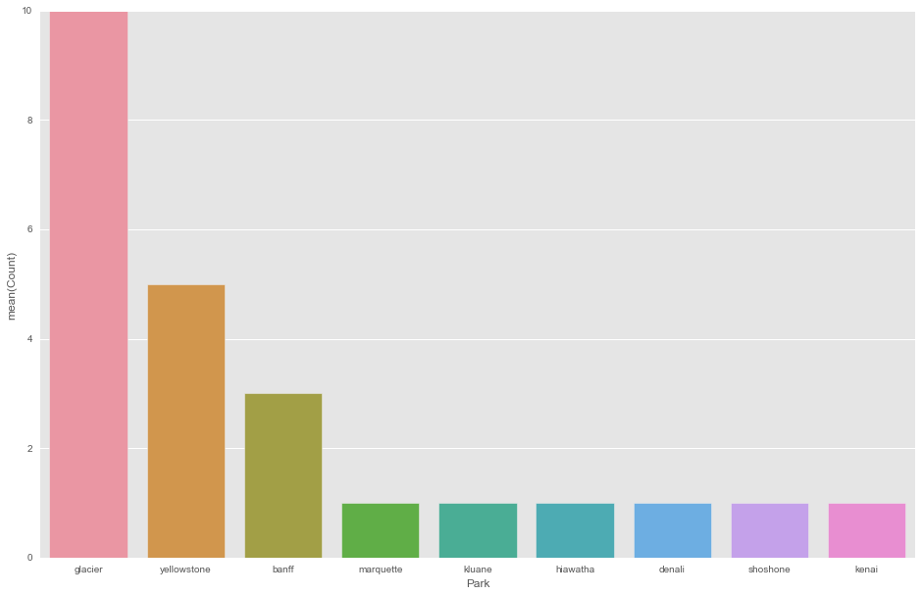
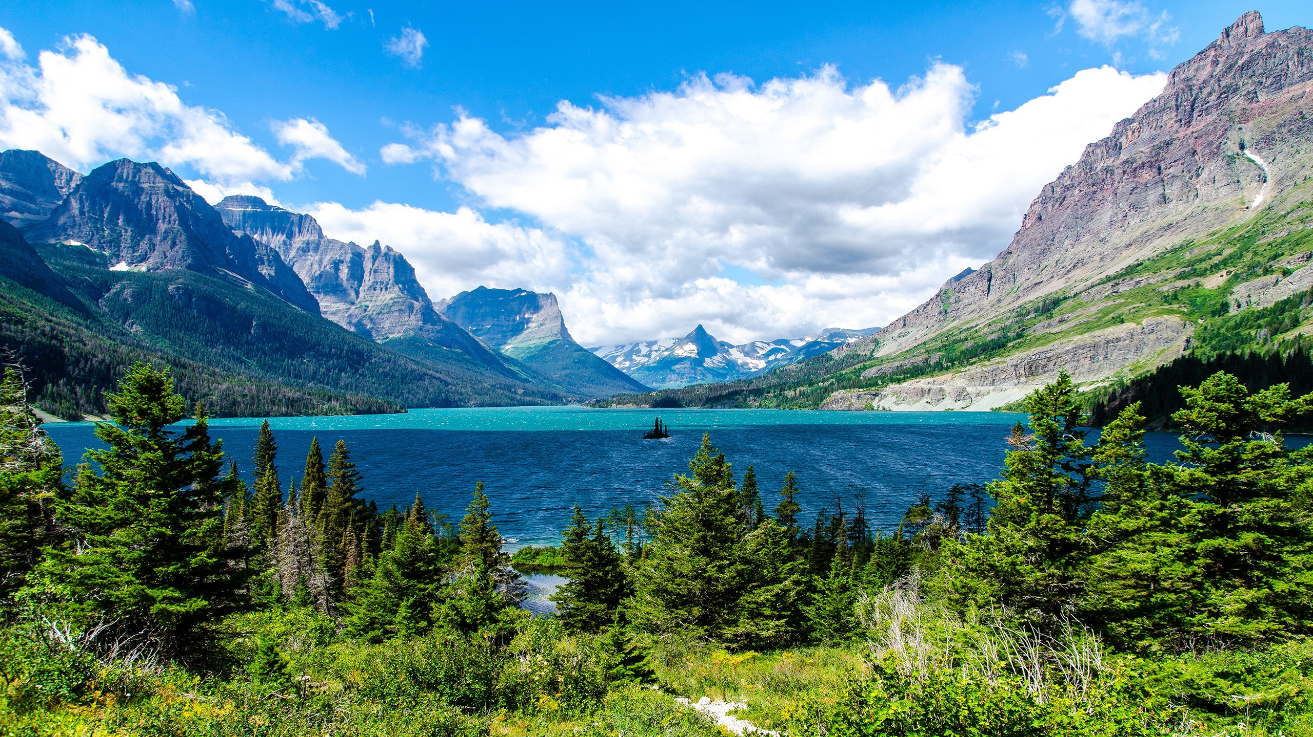
Bear Attacks
Notes:
Unsurprisingly, grizzly bears are the most common. We were surprised that we didn't see any occurrences of kodiak bears, but this is potentially that they're classified as grizzlies or that there are so few of those bears that they don't show up as much (they're also in remote areas).
Looks like back, head, and neck are most common. Not too surprising - a bear is large and can attack large body parts. We don't really have a lot of data here - probably not enough to say anything definitively.
National forests and parks show up a lot. This is not a full sampling of all of the public lands where bear attacks occur, it is simply the ones that showed up in the collocation analysis. However, we do see that Glacier, Yellowstone, and Banff are highly represented - not surprising! What is surprising is that Denali and Kenai (Alaskan parks) are less represented. Potentially because of fewer visitors?

Slide 15
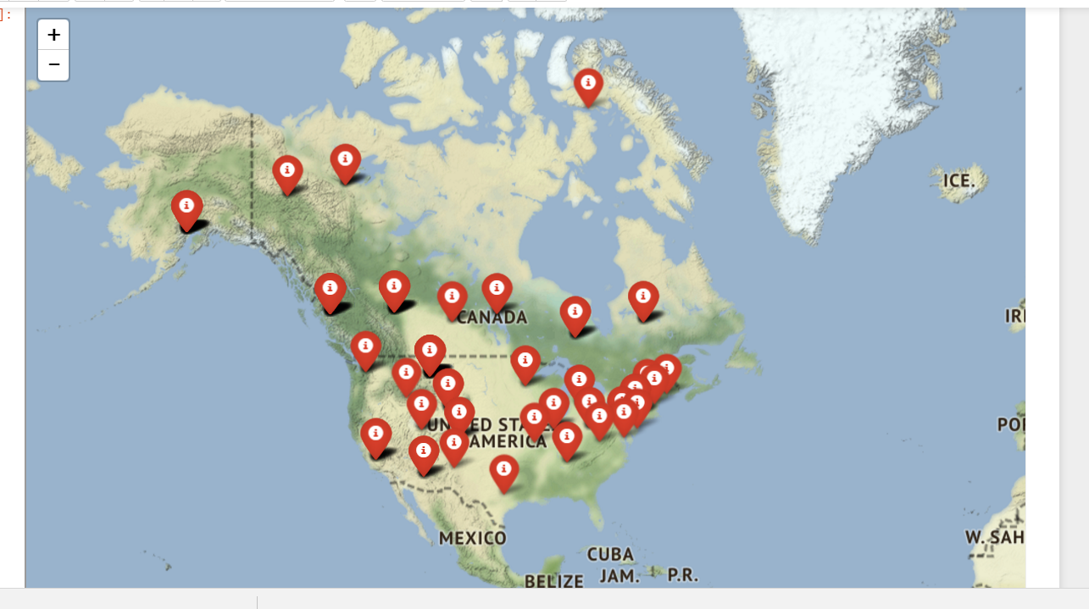
Bear Attack Map
Northeastern cities
Northwestern outdoor areas
Alaska
Canada
Outdoor activities
Entire country represented

Slide 16
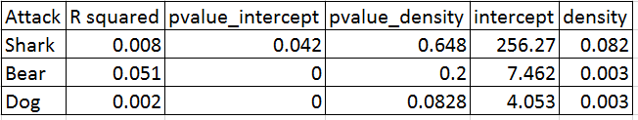

Conclusions
Living in Salt Lake City, you’re not likely to get attacked by a bear, a dog, or a shark.
But don’t visit New Jersey anytime soon.
Notes:
Sharks: Supervised learning did not produce better fatality results than guessing. Shark attacks occurred more frequently in countries with large shark habitats and large populations of ocean-recreating people. We were able to understand the activities that put people at the most risk and some more information about what body parts sharks attack.
Dogs: We didn’t see strong regression data between population density and attack frequency. We did find some interesting information about dog restraints and body part preference in attacks. This conflicts with geospatial plots, because we do see a clustering of attack data on the map.
Bears: We were able to see that grizzly bears attack fatally more frequently than brown or black bears. We see that they have similar body part preference to dogs and that many of these attacks are clustered in public lands, such as National Parks and Forests.
All of the regression models failed to predict animal attacks based on the population density. This could be due to incomplete data acquisition and taking the population density of the country, rather than of the smaller area where attacks occurred.

Slide 17
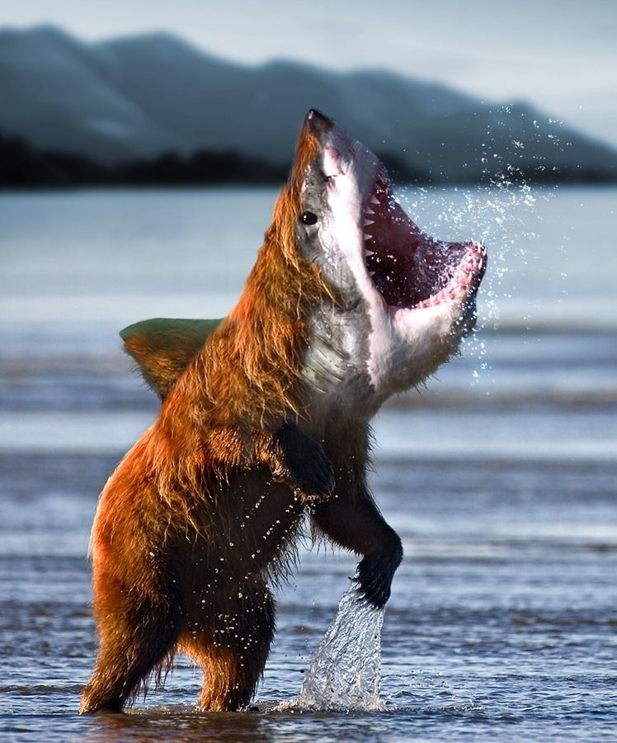
Questions?
Notes:
https://bbs.boingboing.net/t/man-fights-off-bear-attack-near-yosemite-then-drives-himself-to-hospital/63851?page=2

